Slide 1
Toggle Buzz Pane
Buzz Main Menu Options
Universal Compose

Slide 2
APP Infrastructure Backend is Done
API
Code Complete
Data Tier
To Build
Cache
Persistent Storage
Identity, Authentication
&
Application Security
Application Backend
Function Libraries
Application Client
Browser
Mobile Browser
Native App
HTML, CSS, JS
Just Add HTML, CSS, JS Client

Slide 3


Slide 4
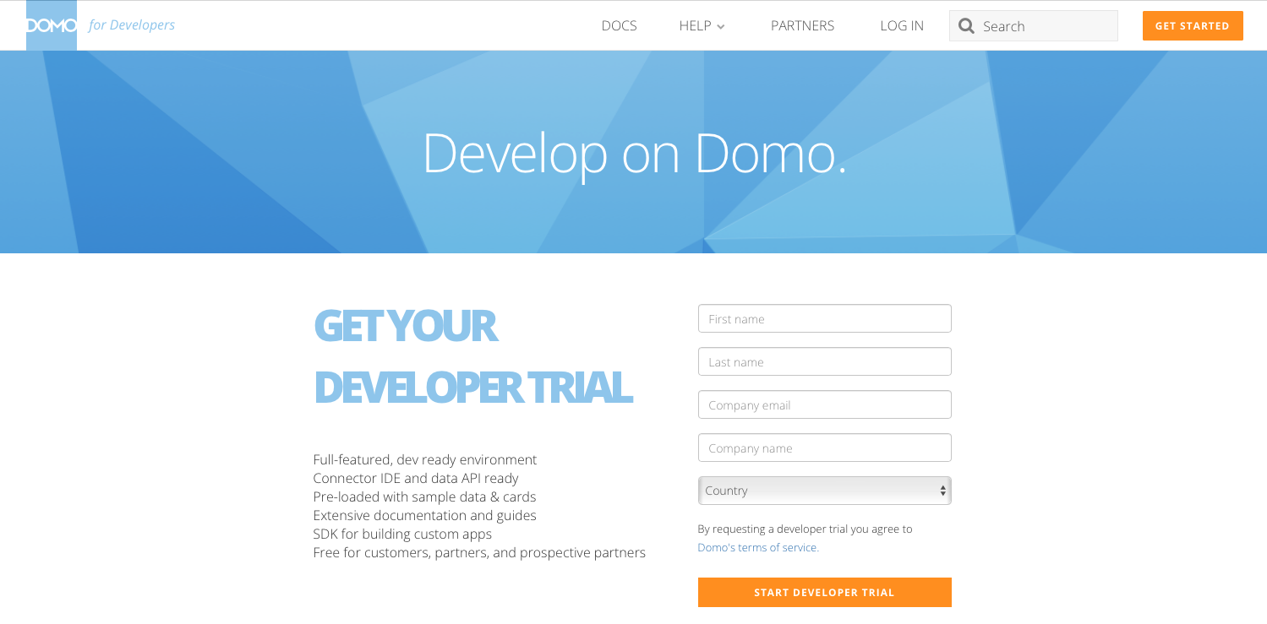

Slide 5
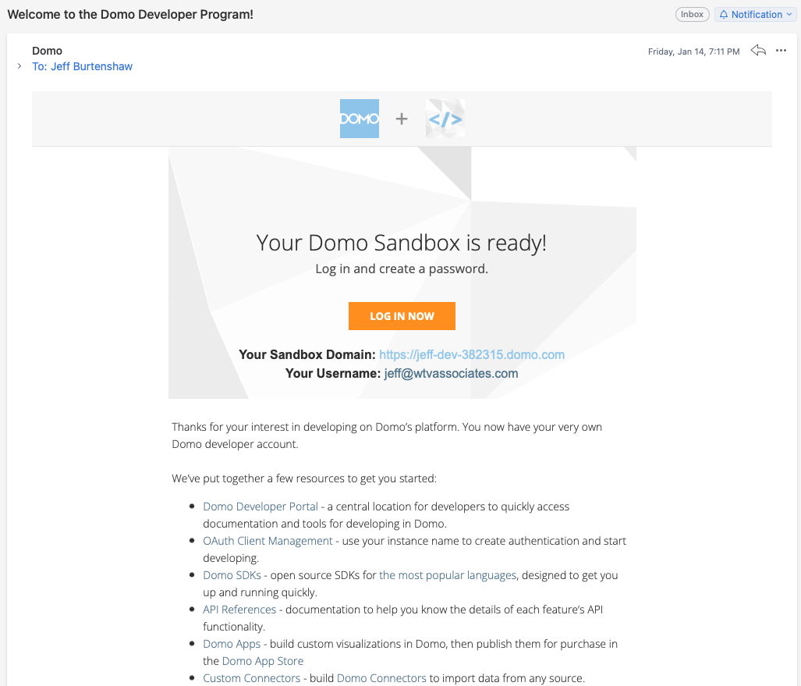


Slide 6
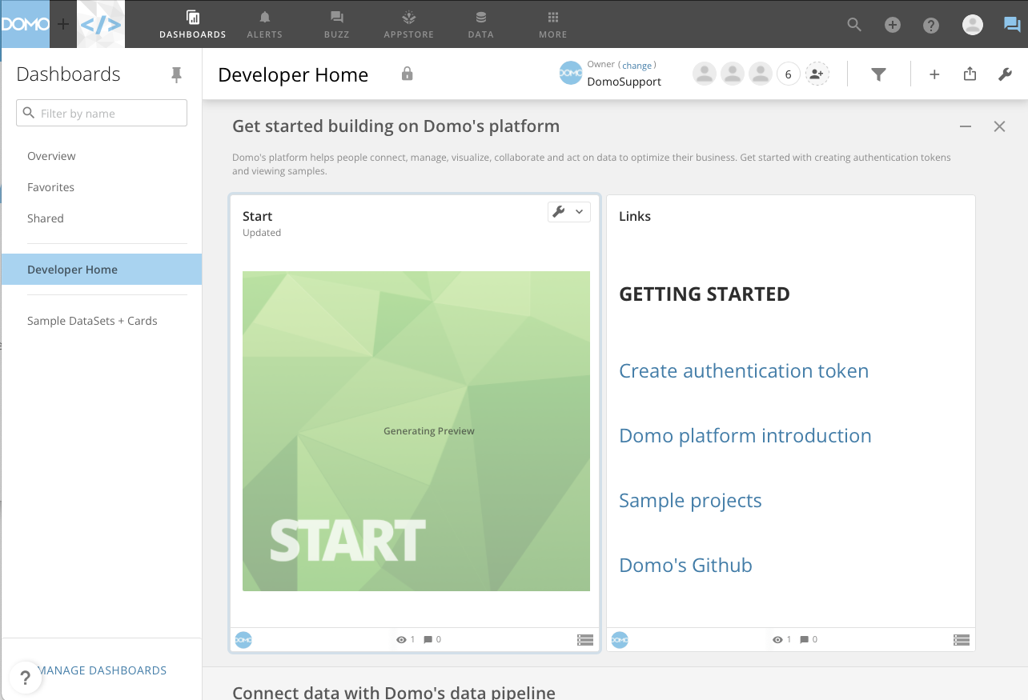

Slide 7
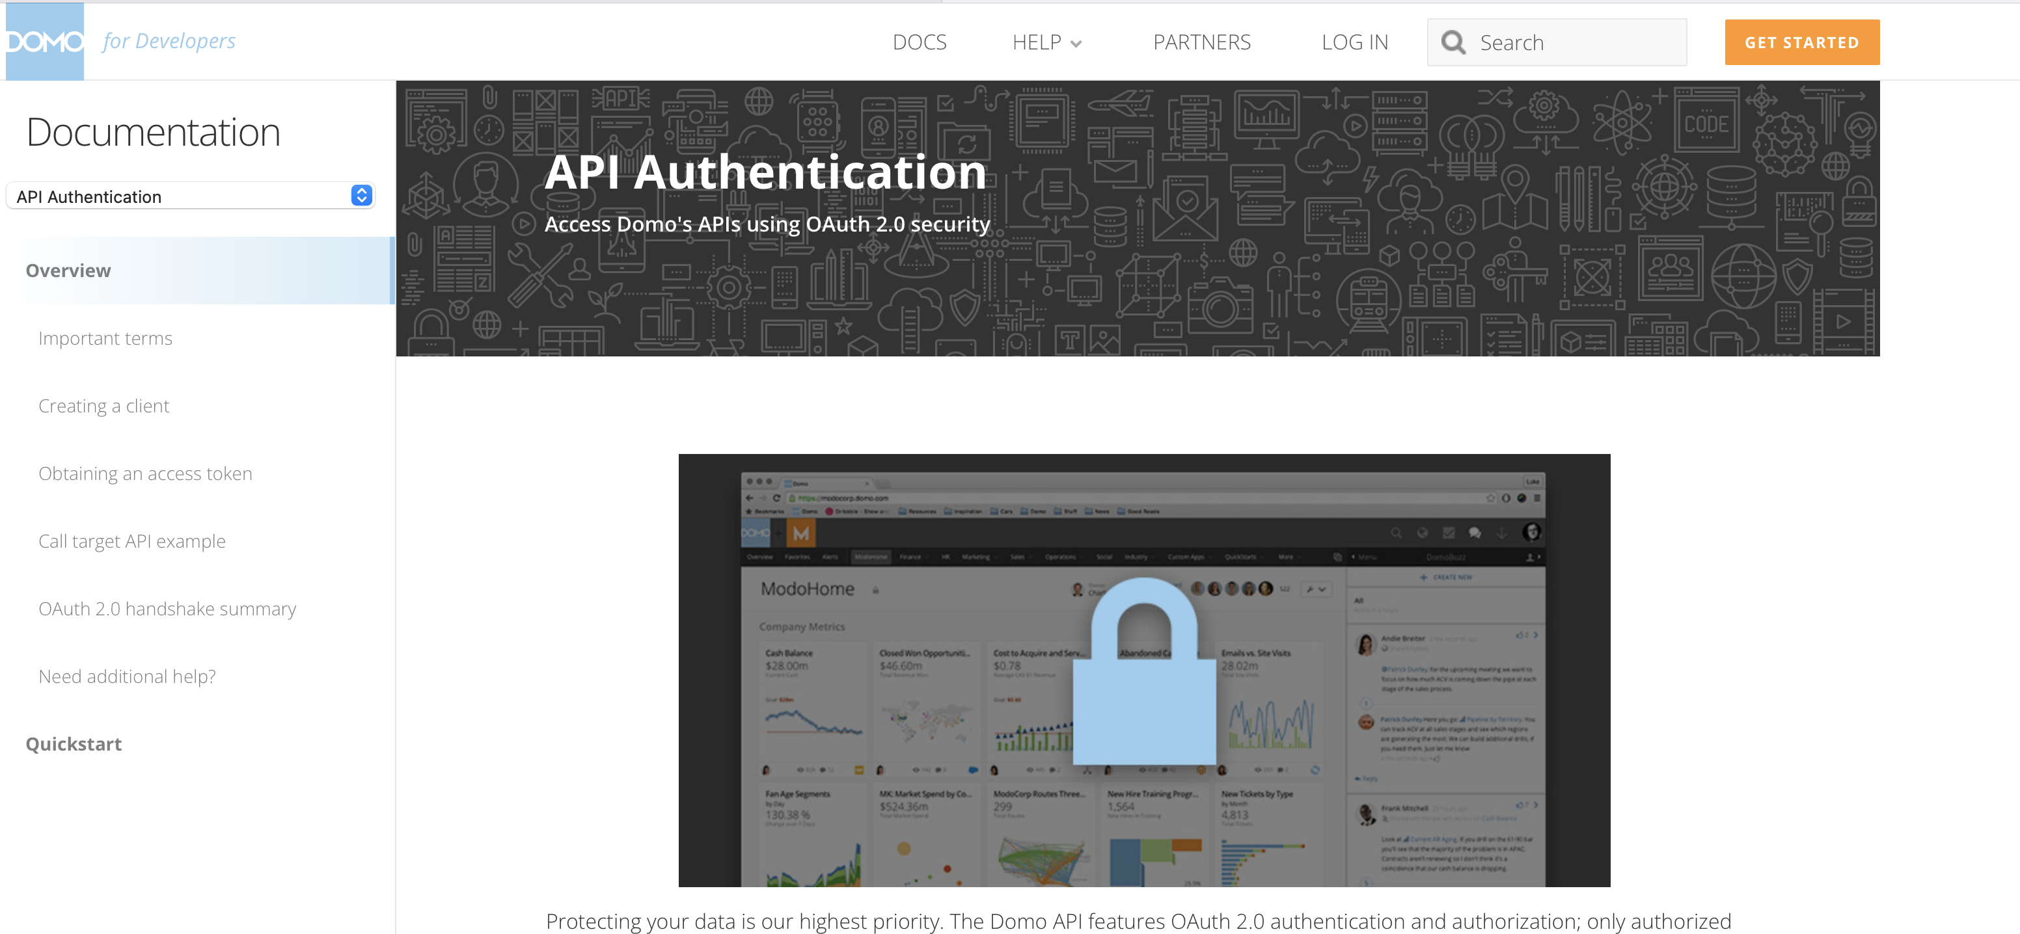

Slide 8
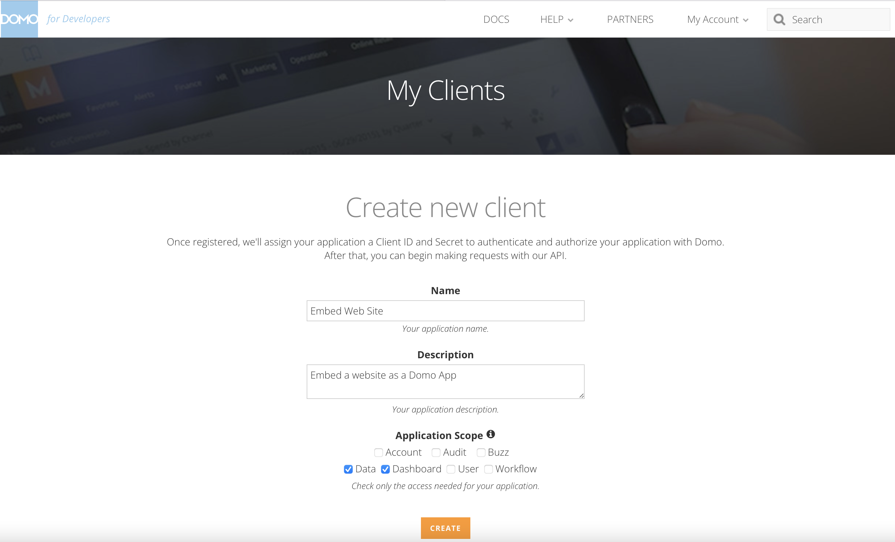

Slide 9
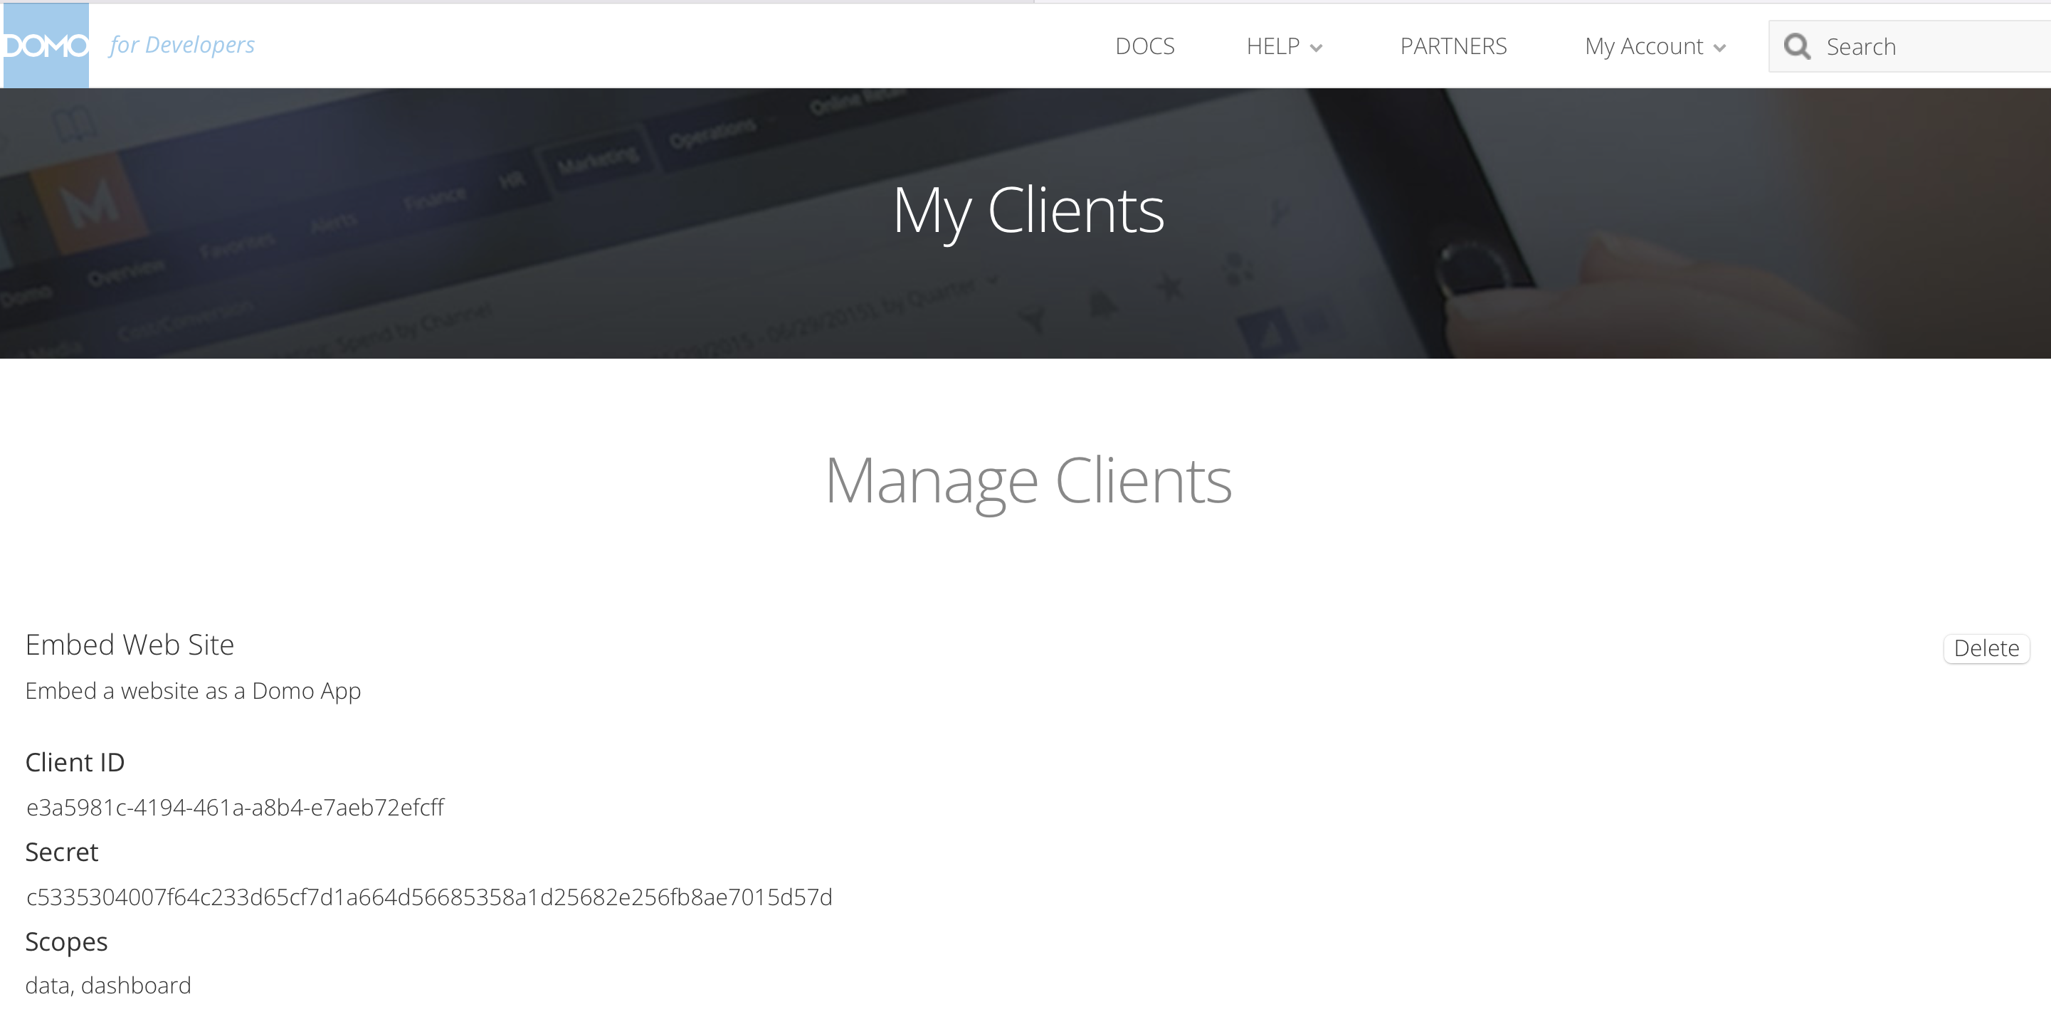

Slide 10
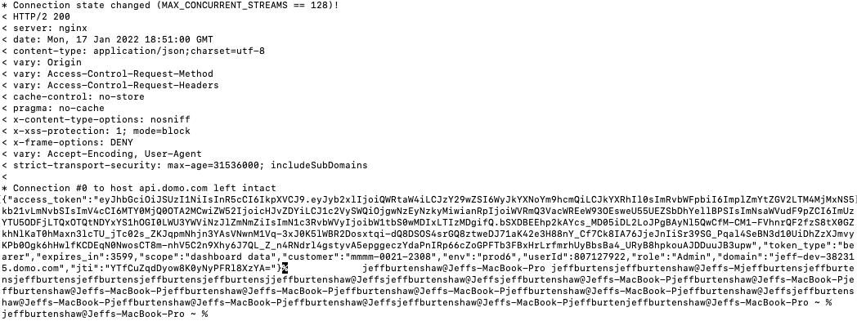

Slide 12
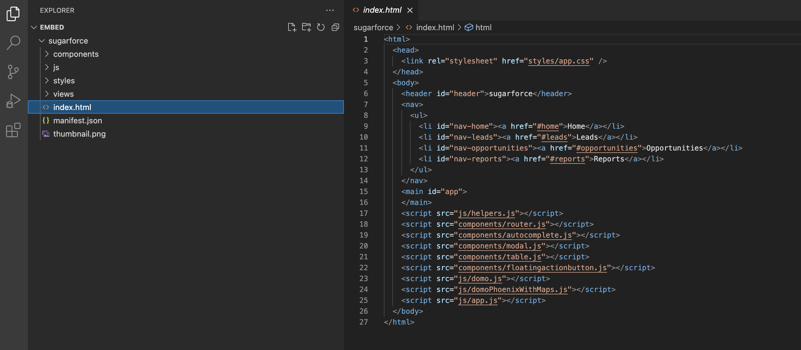

Slide 13
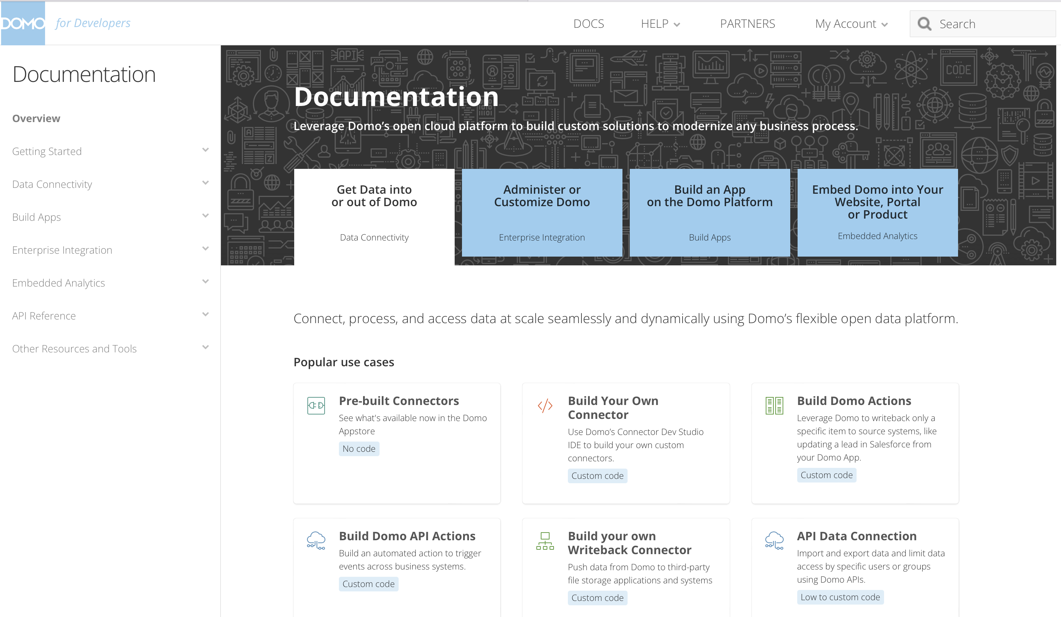

Slide 14
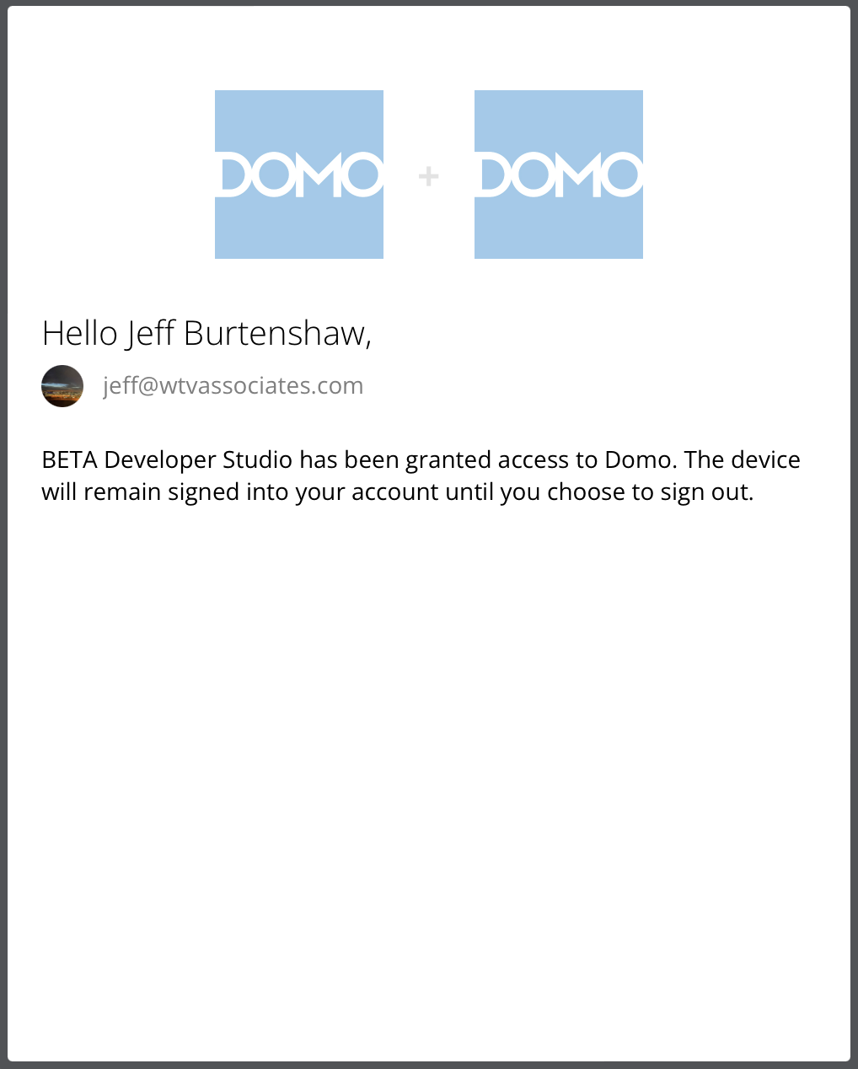

Slide 15
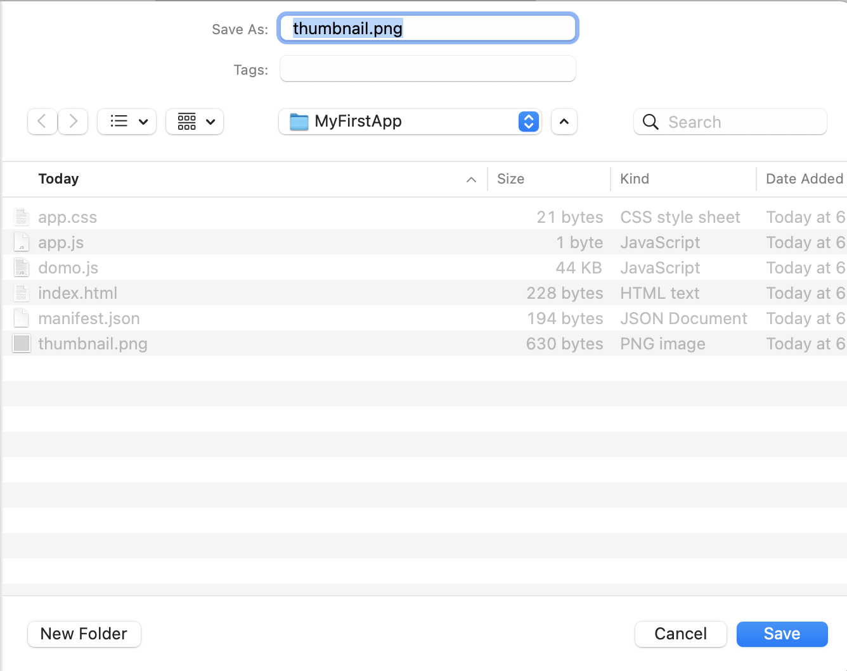

Slide 16
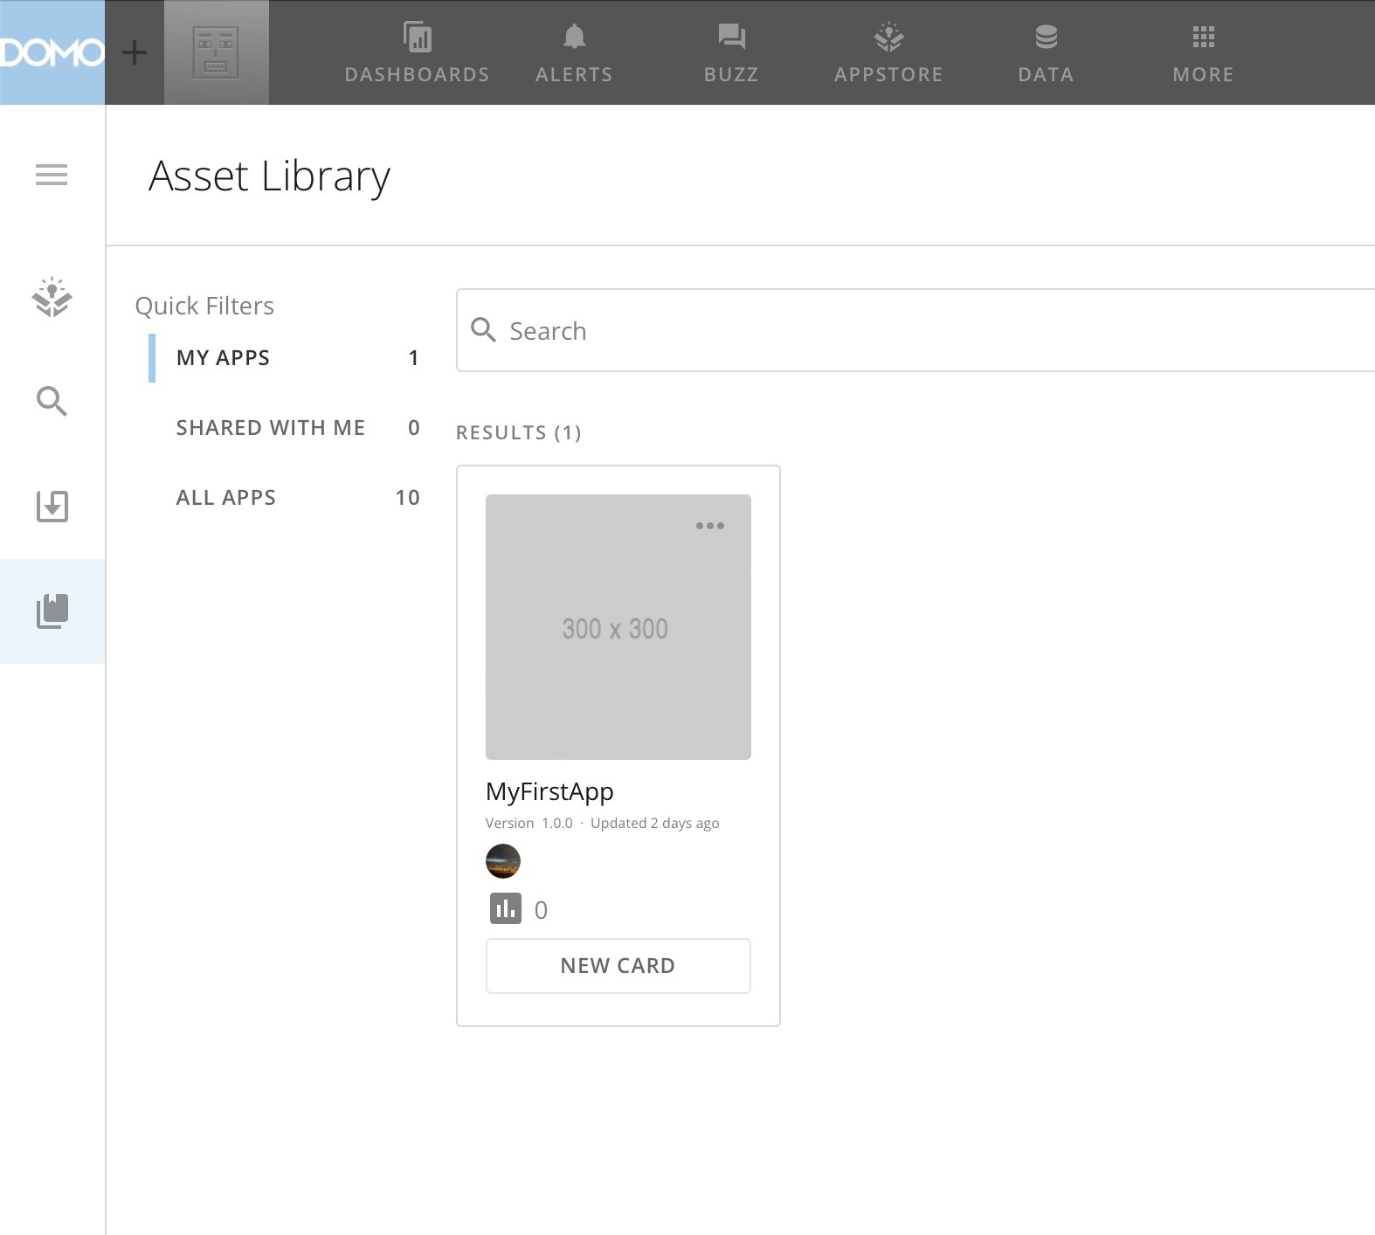

Slide 17
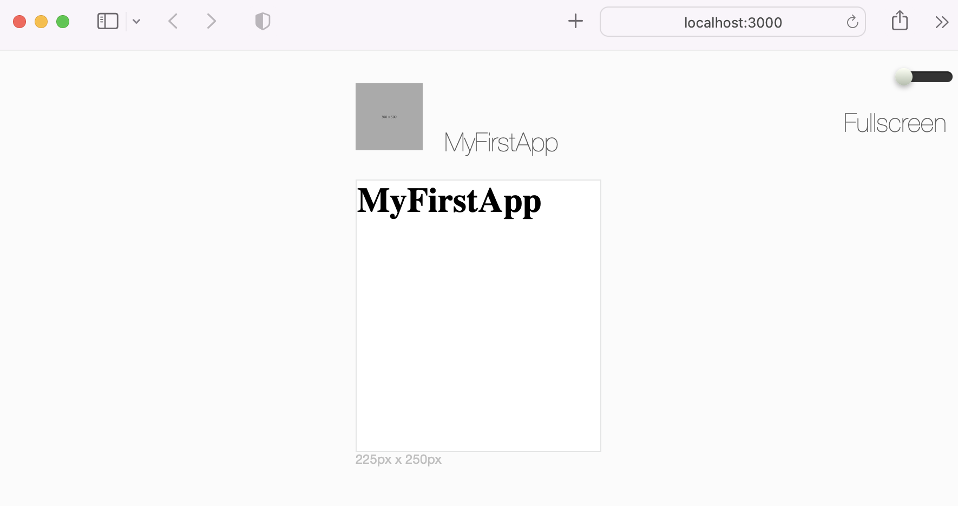

Slide 18
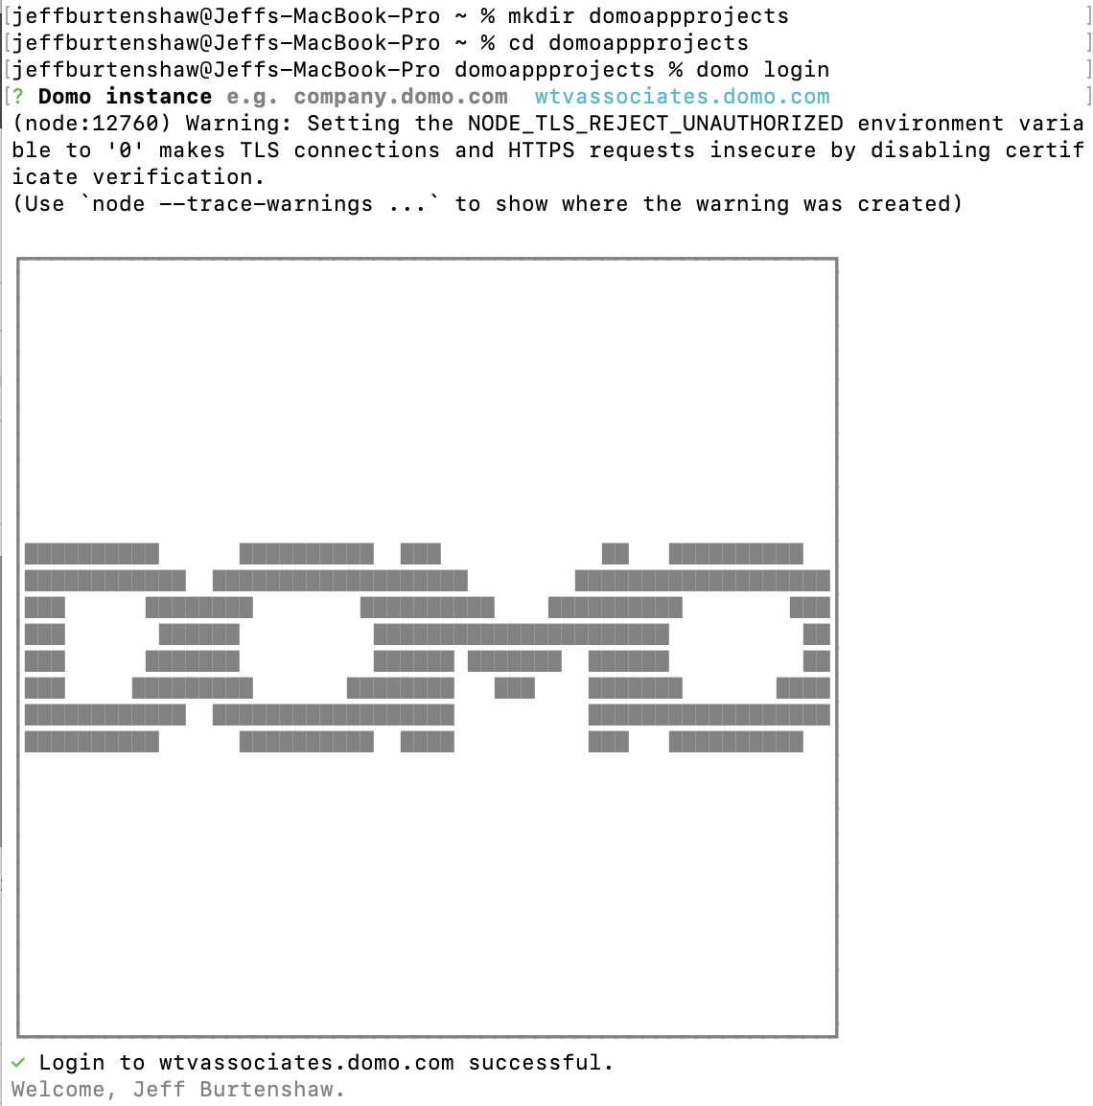
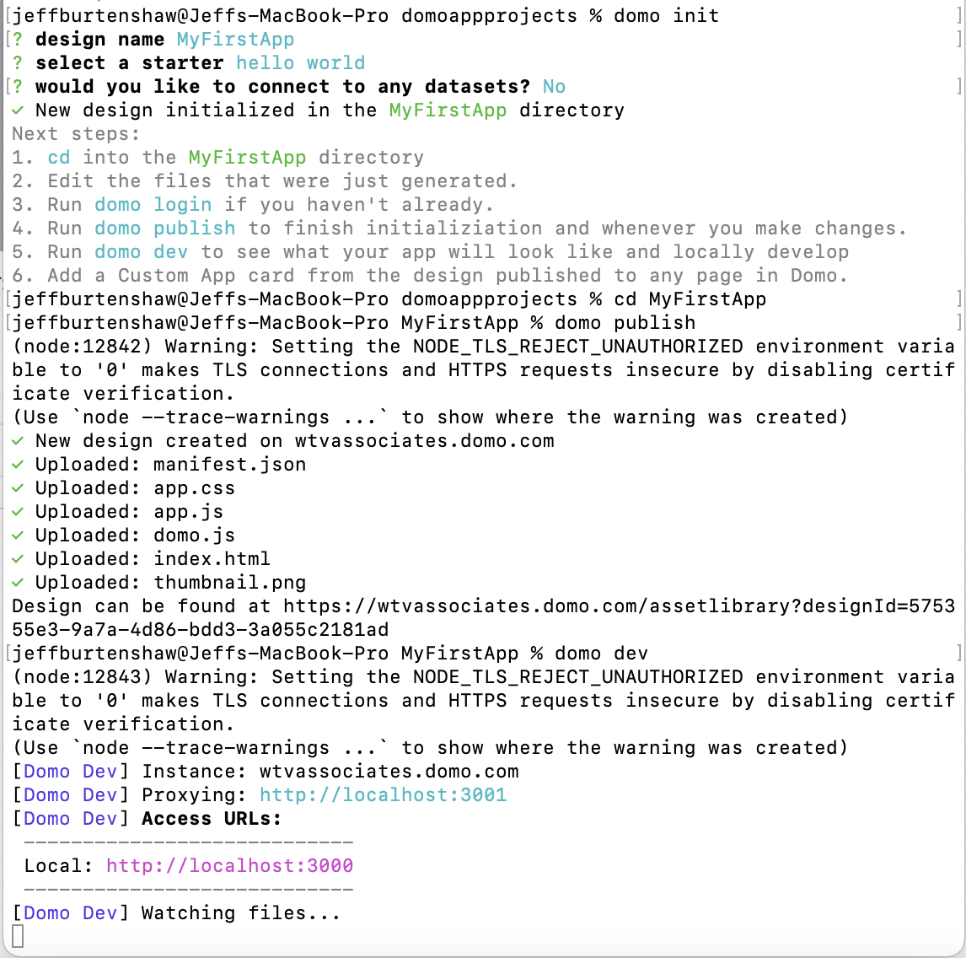

Slide 19
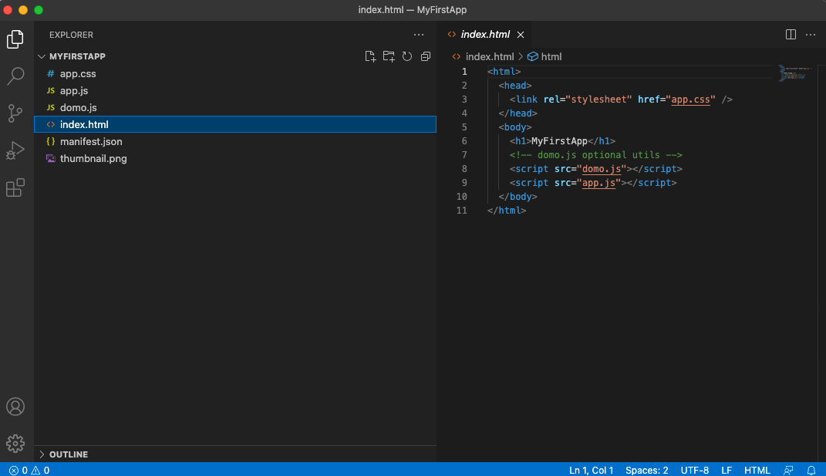

Slide 20
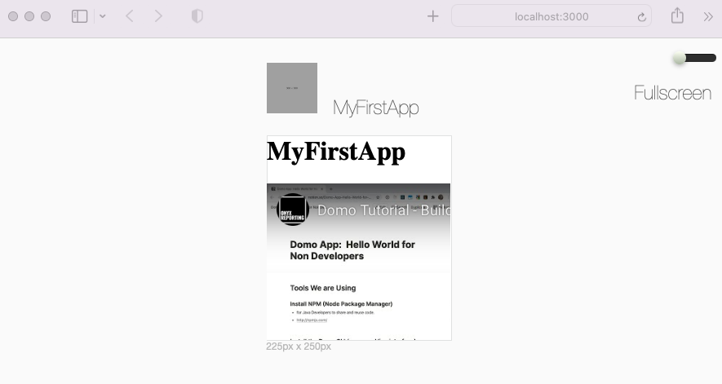

Slide 21
